Slide 1
BRANCH AND BOUND
by -
KARTIK SHAURYA (181210026)
HIMANSHU SRIVASTAVA (181220031) - last roll no.

Slide 2
INTRODUCTION
Branch and bound is an algorithm design
paradigm which is generally used for solving
combinatorial optimization problems.

Slide 3
INTRODUCTION
These problems are typically exponential in terms of time complexity and may require exploring all possible permutations in worst case.
The Branch and Bound Algorithm technique solves these problems relatively quickly.

Slide 4
PROBLEM STATEMENT
The ” N QUEENS PUZZLE ” is the problem of placing N chess queens on an N×N chessboard in such a way that no two queens threaten each other.
Thus, a solution requires that no two queens share the same row, column, or diagonal.

Slide 5
SOLUTION APPROACH
Basically, we have to ensure 4 things -:
No two queens share a column.
No two queens share a row.
No two queens share a top-right to left-bottom diagonal.
No two queens share a top-left to bottom-right diagonal.

Slide 6
SOLUTION APPROACH
Number 1 is automatic because of the way we store the solution.
For number 2, 3 and 4, we can perform updates in O(1) time.
The idea is to keep three Boolean arrays that tell us which rows and which diagonals are occupied.

Slide 7
SOLUTION APPROACH
Let’s create two N x N matrix one for / diagonal and other one for \ diagonal. Let’s call them slashCode and backslashCode respectively.
The trick is to fill them in such a way that two queens sharing a same /­ diagonal will have the same value in matrix slashCode, and if they share same \­ diagonal, they will have the same value in backslashCode matrix.

Slide 8
SOLUTION APPROACH
For an N x N matrix, fill slashCode and backslashCode matrix using formula - :
slashCode [row][col] = row + col
backslashCode [row][col] = row - col + (N-1)

Slide 9
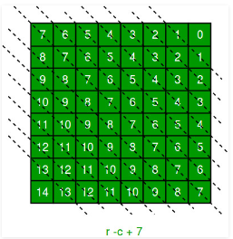
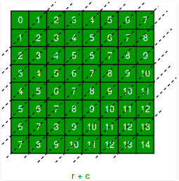
SOLUTION APPROACH
For N = 8 The ‘N – 1’ in the backslash code is there to ensure that the codes are never negative because we will be using the codes as indices in an array.

Slide 10
SOLUTION APPROACH
Now before we place queen i on row j, we first check whether row j is used (use an array to store row info).
Then we check whether slash code ( j + i ) or backslash code ( j – i + 7 ) are used (keep two arrays that will tell us which diagonals are occupied).
If yes, then we have to try a different location for queen i.
If not, then we mark the row and the two diagonals as used and recurse on queen i + 1.

Slide 11
SOLUTION APPROACH
After the recursive call returns and before we try another position for queen i,
we need to reset the three things -:
row
slash code
backslash code

